Slide 1
Most Valuable Players
Mitchell Boult
Hunter Tanner
Gardy Anger
Tabassum Choudhury
Timea Jakab

Slide 2
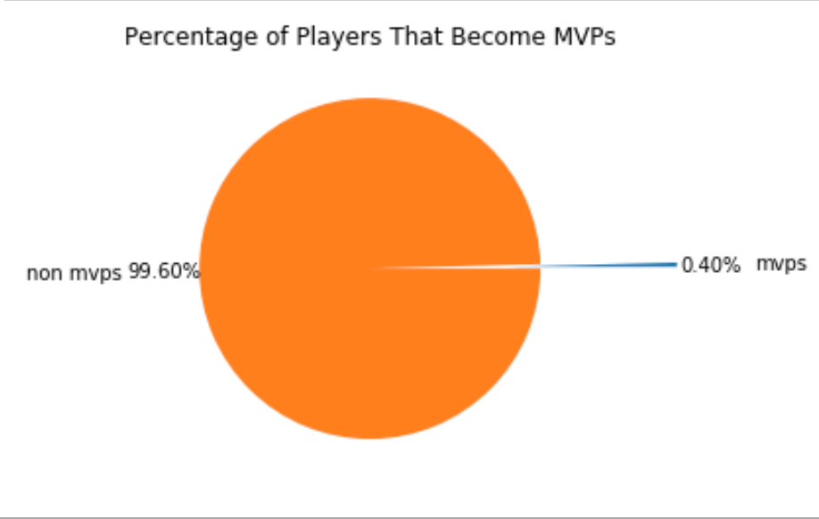
Project Overview:
Over 8000 drafted in 75 seasons
Only 35 players voted season MVP
What makes these 35 special?
- Hypothesis 1:
There is one institution (either college or franchise ) developing/idenitifing talent better that better than the rest
- Hypothesis 2:
One position is more probable to become MVP
- Hypothesis 3:
- MVPs have physical attributes that set them apart

Slide 3
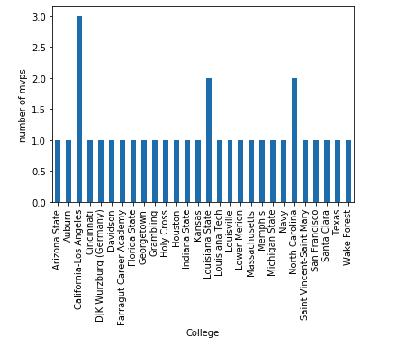
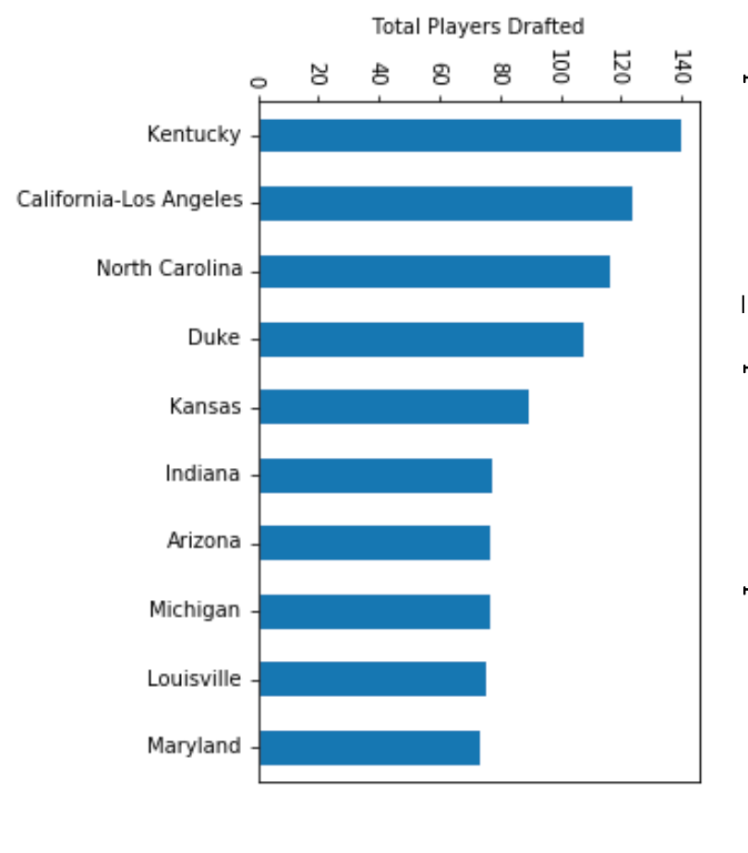
Hypothesis 1: One institution ( college or pro team ) develops/identifies talent better that better than the rest
Certain colleges produce more NBA caliber talent but, with the number of MVPs per school having a standard deviation of .456, there is not one that seems to give much of an advantage
UCLA does have the most with 3

Slide 4
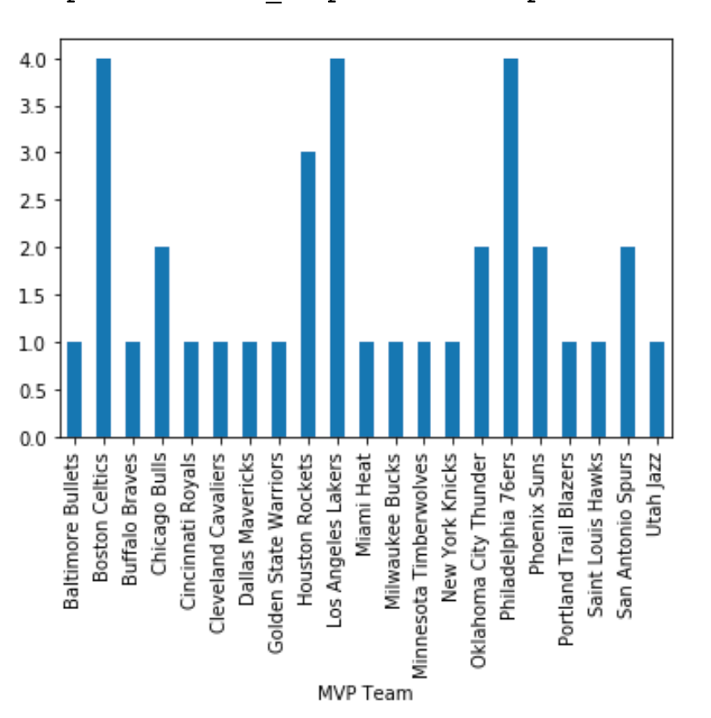
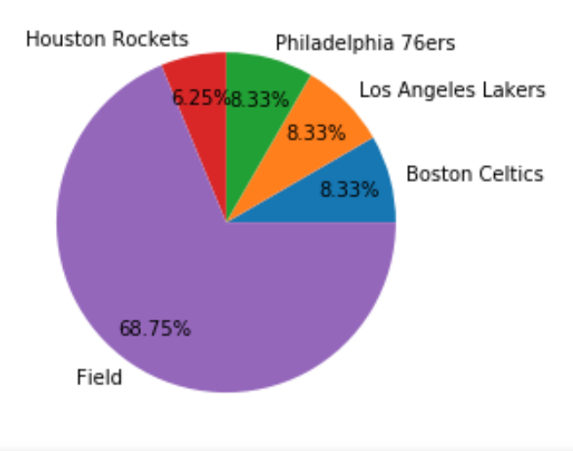
Hypothesis 1: cont.
Historically the Celtics(4), Rockets(3), 76ers(4) & Lakers(4) produced a third of all MVPs
The rest of the NBA averages 1 MVP if any.

Slide 5
Hypothesis 1 Conclusion:
While the college a player attends can be an indicator of potential NBA talent, the college a player attends doesn’t indicate MVP potential.
Once they get into the league, players that play for the Celtics, Lakers, and 76er are more likely to be in MVP considers.

Slide 6
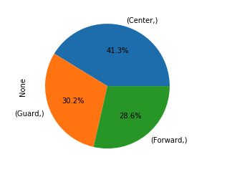
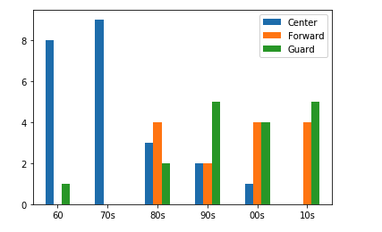
Hypothesis 2: One position is more probable to become MVP
Hypothesis
Until the 1979- 80 season, the MVP was selected by a vote of NBA players. Since the 1980 -81 season the award is decided by a panel of sportswriters and broadcasters throughout the US . Each member of the voting panel casts a vote for the first and gift place selections on top of this the 3-point liner was introduces the same year. Our hypothesis is that this had a direct impact on the probability of one becoming MVP
Based on our analysis, the ‘’center” position and also the tallest player on each team, usually playing near the basket has been predominantly winning the title of MVP until the late 70’s.
Once the new measure is implemented in the 80’s we are seeing a more even playing field in terms of positions that will more likely win the title of MVP.

Slide 7
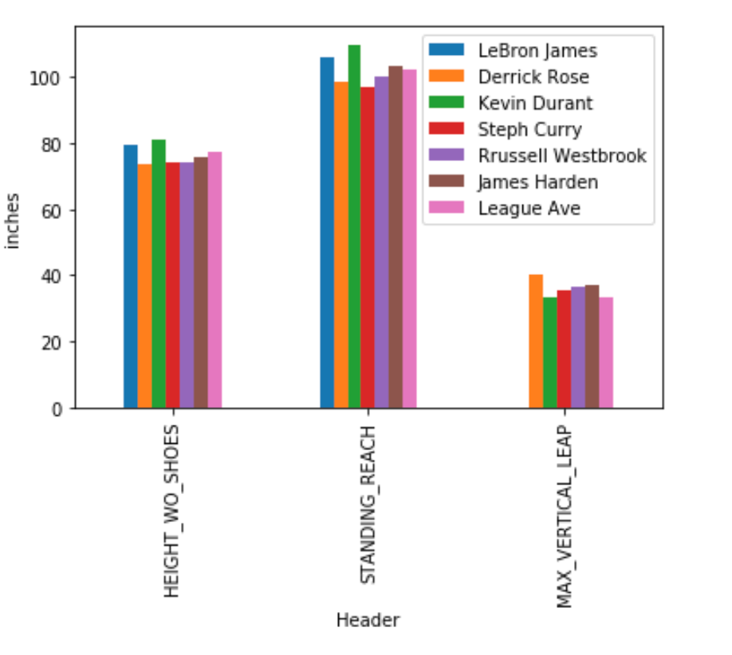
Hypothesis 3:
MVPs have physical attributes that set them apart
The NBA hosts a combine ever year for the world’s top prospects. Over the last 20 years, stats like Height, Reach and Vertical Leap have been record for every player that attends the combine.
Given the athletic nature of basketball,Do MVPs must have above average physical attributes?
We compared the Height, Reach and Vertical Leap of Lebron James, Derrick Rose,Kevin Durant, Steph Curry, Russell Westbrook and James Harden( every MVP that attended the combine) to the league average.
MVPs ability to jump high is an advantage, while their Height and Reach for the majority of the MVPS were below the league average

Slide 8
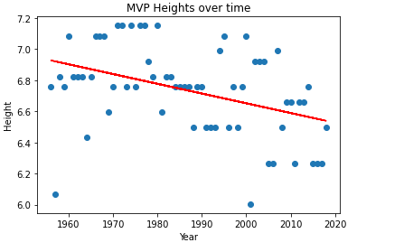
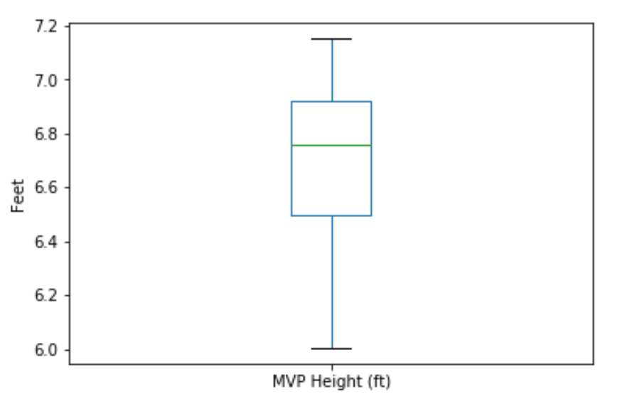
Hypothesis 3: Cont.
-Infact, over the last 60 years, there has been a steady line regression of years.
-The correlation between height and year has dropped .403 inches. With the lowest quartile being 6.5ft and highest quartile being 6.9. However, 6.75 is the ideal height to look for when predicting possible MVPs

Slide 9
Hypothesis 3 Conclusion:
There’s is no real physical attributes that give mvps an advantage,so there skill set is what is setting them.
MVPs are expected to contribute more than any other players in their team, not to say in the entire league.
Besides media vote, a player’s consistent performance matters.
Notes:
There are multiple players that have those physical attributes. But one thing that all mvps have in common is their ability to impact the game. What are the metrics used to measure those impacts?

Slide 10
MVP Metrics
Three primary rubrics to enter the mvp contention list:
Average point per game
Average rebound per game
Average assist per game

Slide 11
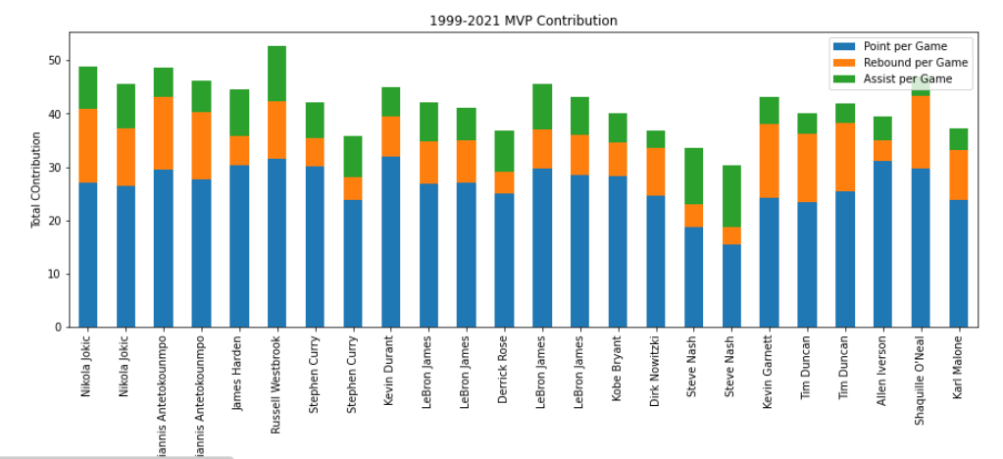
Rubric over the past two decades
Notes:
Here is a quick overview of mvps over the past two decades.

Slide 12
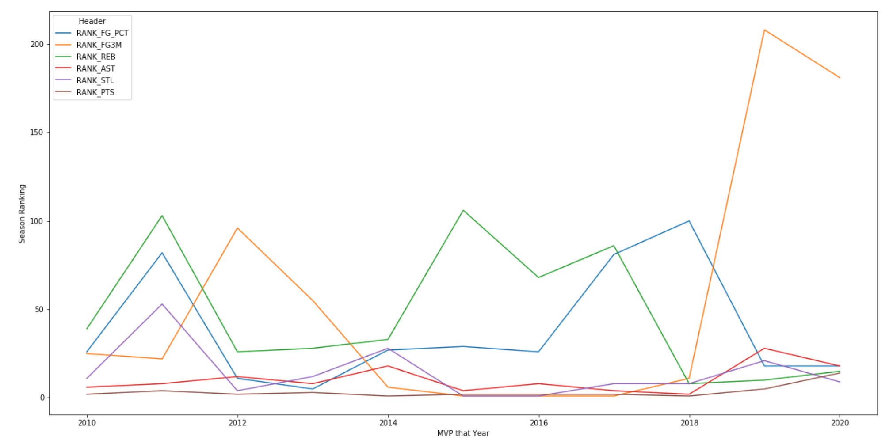
Hypothesis 3 conclusion
Physical attributes coupled with consistent performance

Slide 13
Conclusion
The path to the NBA is less important than the Team they are playing but both are big factors
Since the 80’s the position they play is less important
skill and consistency is more important than physical attributes.
While size can help, basketball is a game of skill and finesse

